Slide 1
天马望远镜单天线终端及数据处理
吴亚军，上海天文台
虚拟天文台与天文信息学2019年会
大庆，2019/11/27-30

Slide 2
Contents
The Tianma Radio Telescope
The Backends
  DIBAS: for Spectroscopy and Pulsar;
  Spectrometer: for Spectroscopy
  FRB: Real-time detecting;
The Data
  Observation and Data
  Database

Slide 3
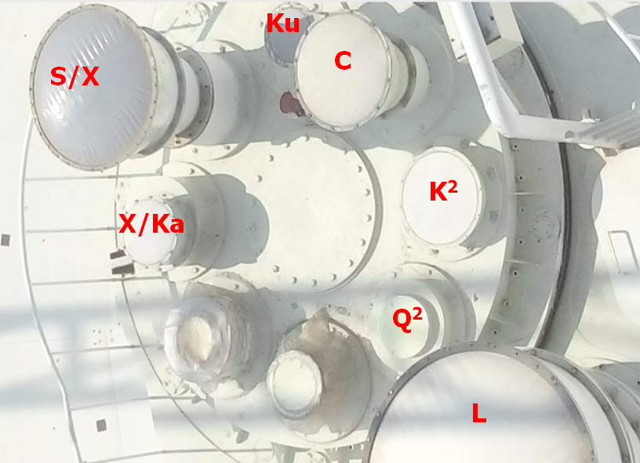
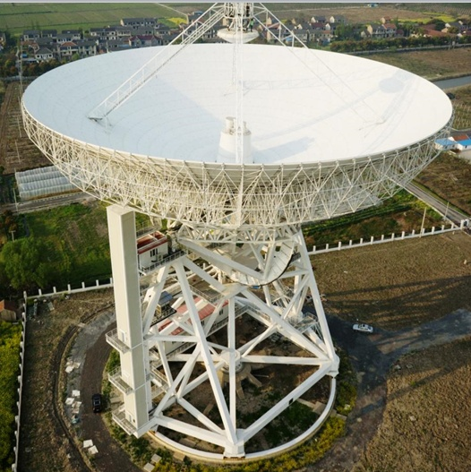
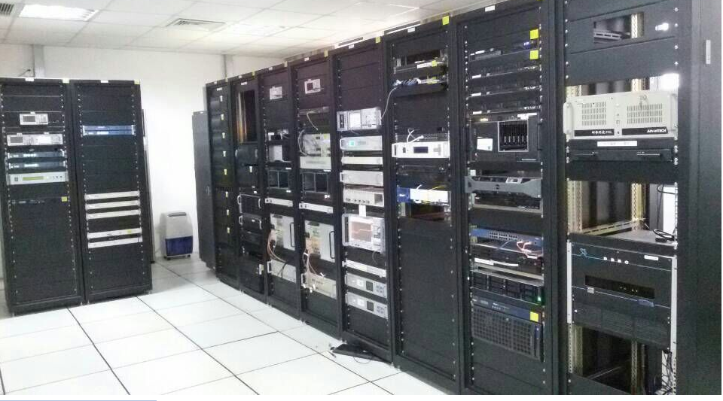
The Tianma telescope
Ka²
K7

Slide 4
The Backends and Sciences
终端：数据采集、处理和存储；
技术与科学的桥梁

Slide 5
The Backends
DIBAS
Spectrometer
Real-time FRB

Slide 6
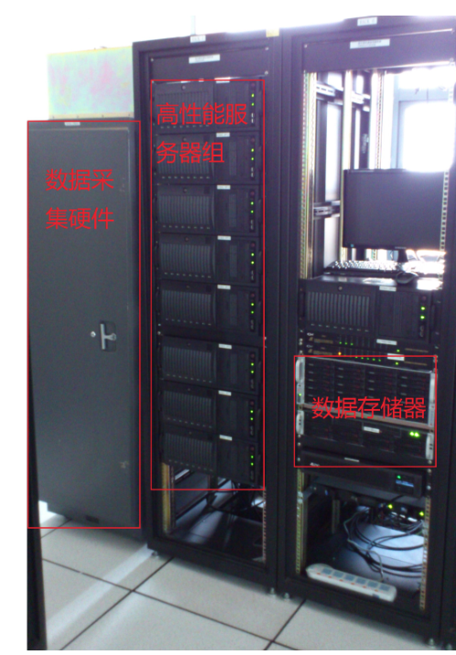
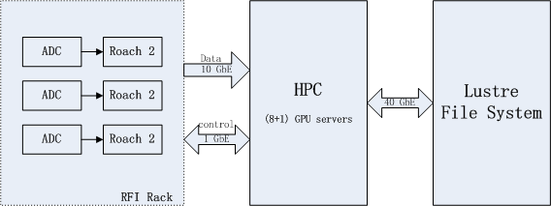
DIBAS
Imported from NRAO；
Support for Spectroscopic and Pulsar Observations
3 Bank, each 1.5GHz Bandwidth;

Slide 7
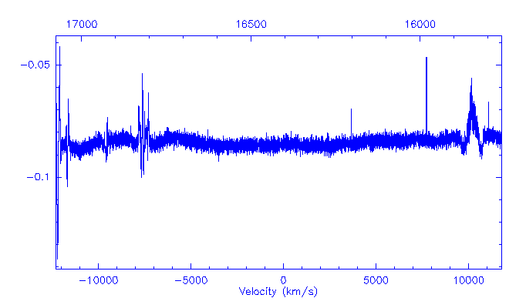

The Spectrometer: Background
HC₉N(29-28)
HC₇N(14-13)
HC₇N(15-14)
HC₅N(6-5)
DIBAS(now)：3 Banks, each 1.5 GHz BW;
Background:
  Sensitivity is good;
  Ka/Q Band: > 10GHz BW, line survey;
  7-element K Receiver in design;
  Need more banks, high resolution
3-hours observation on IRC10216, velocity range(-12000~12000 km/s), 1$σ=4.5 mJy$

Slide 8
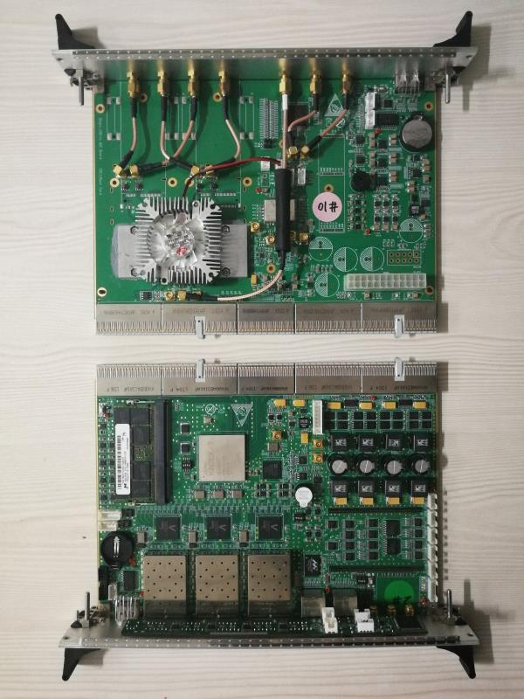
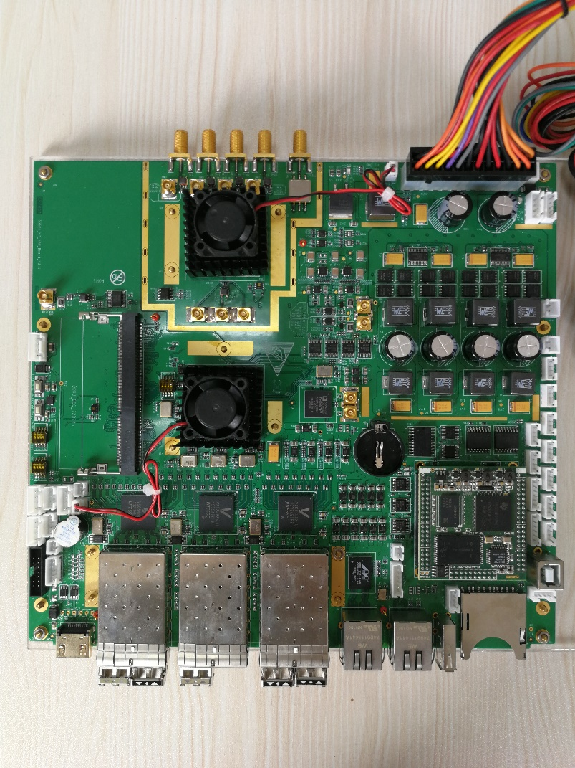
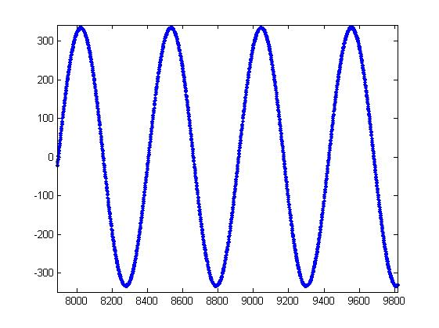
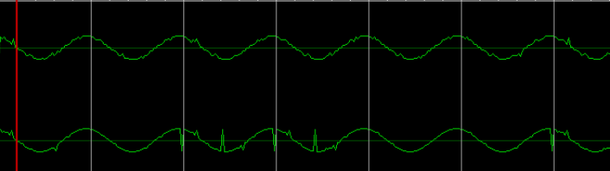
The spectrometer: Hardware
5Gsps ADC, Xilinx Kintex7 FPGA; 10Gb网络；
Version 1
Version 2
Improve the interface between ADC and FPGA

Slide 9
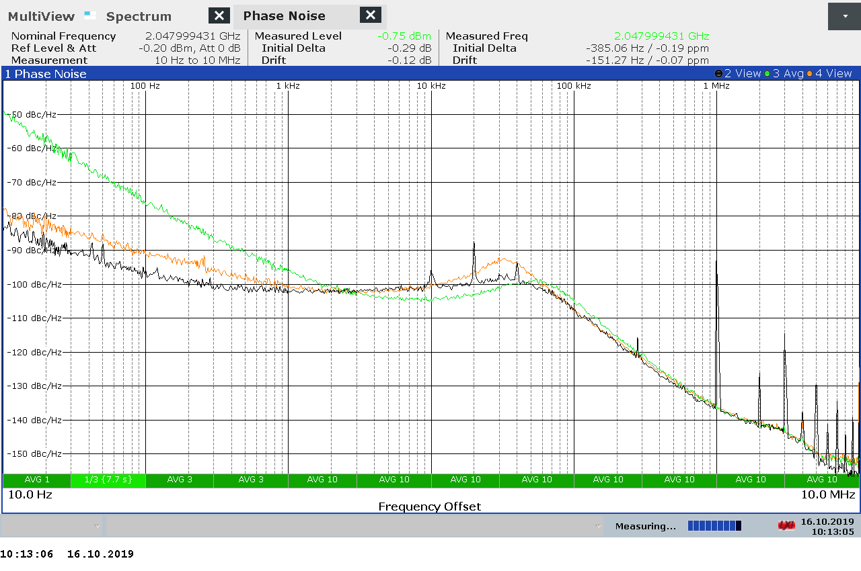
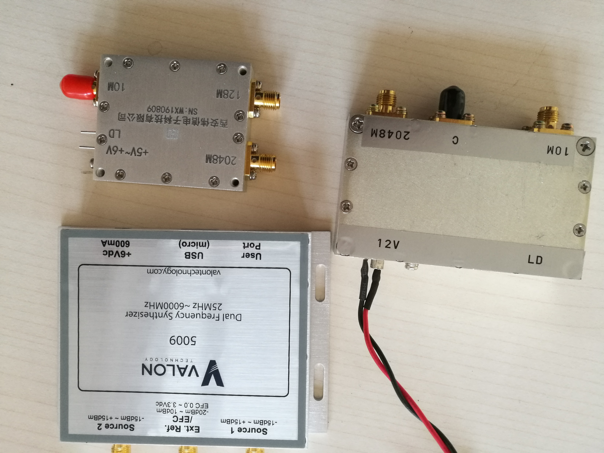
The spectrometer: Synthesizer and ADC
Synthesizer:
ADC ENOB
Fin(MHz) |  | 20190927 | 20190927 | 20190929
 | ENOB | ENOB | ENOB | ENOB
10 | 7.33 | 7.31 | 7.30 | 7.29
110 | 7.19 | 7.25 | 7.23 | 7.23
210 | 6.87 | 7.25 | 7.34 | 7.27
410 | 6.17 | 6.79 | 6.78 | 6.76
810 | 5.43 | 6.94 | 6.86 | 6.81
1210 | 4.93 | 6.60 | 6.46 | 6.36
1610 | 4.51 | 5.96 | 6.27 | 6.24
1810 |  |  | 5.89 | 6.04
2
1
3
The performance of Spectrometer

Slide 10
The spectrometer: FPGA Code
Mode | Window(s) | Bandwidth （MHz） | Channel(s) | Freq. Resolution(KHz) | Velcity Resolution(Km/s) @10GHz | processor
Mode1 | 1 | 2048 | 131072 | 15.625 | 0.468 | FPGA
Mode2 | 2 | 256 | 65536 | 3.906 | 0.117 | FPGA
Mode3 | 8 | 32 | 65536 | 0.488 | 0.015 | FPGA+GPU
Mode1 in progress; others in plan;
FPGA, Software, and Control in discussion;
noise in
10 MHz in
Mode1

Slide 11
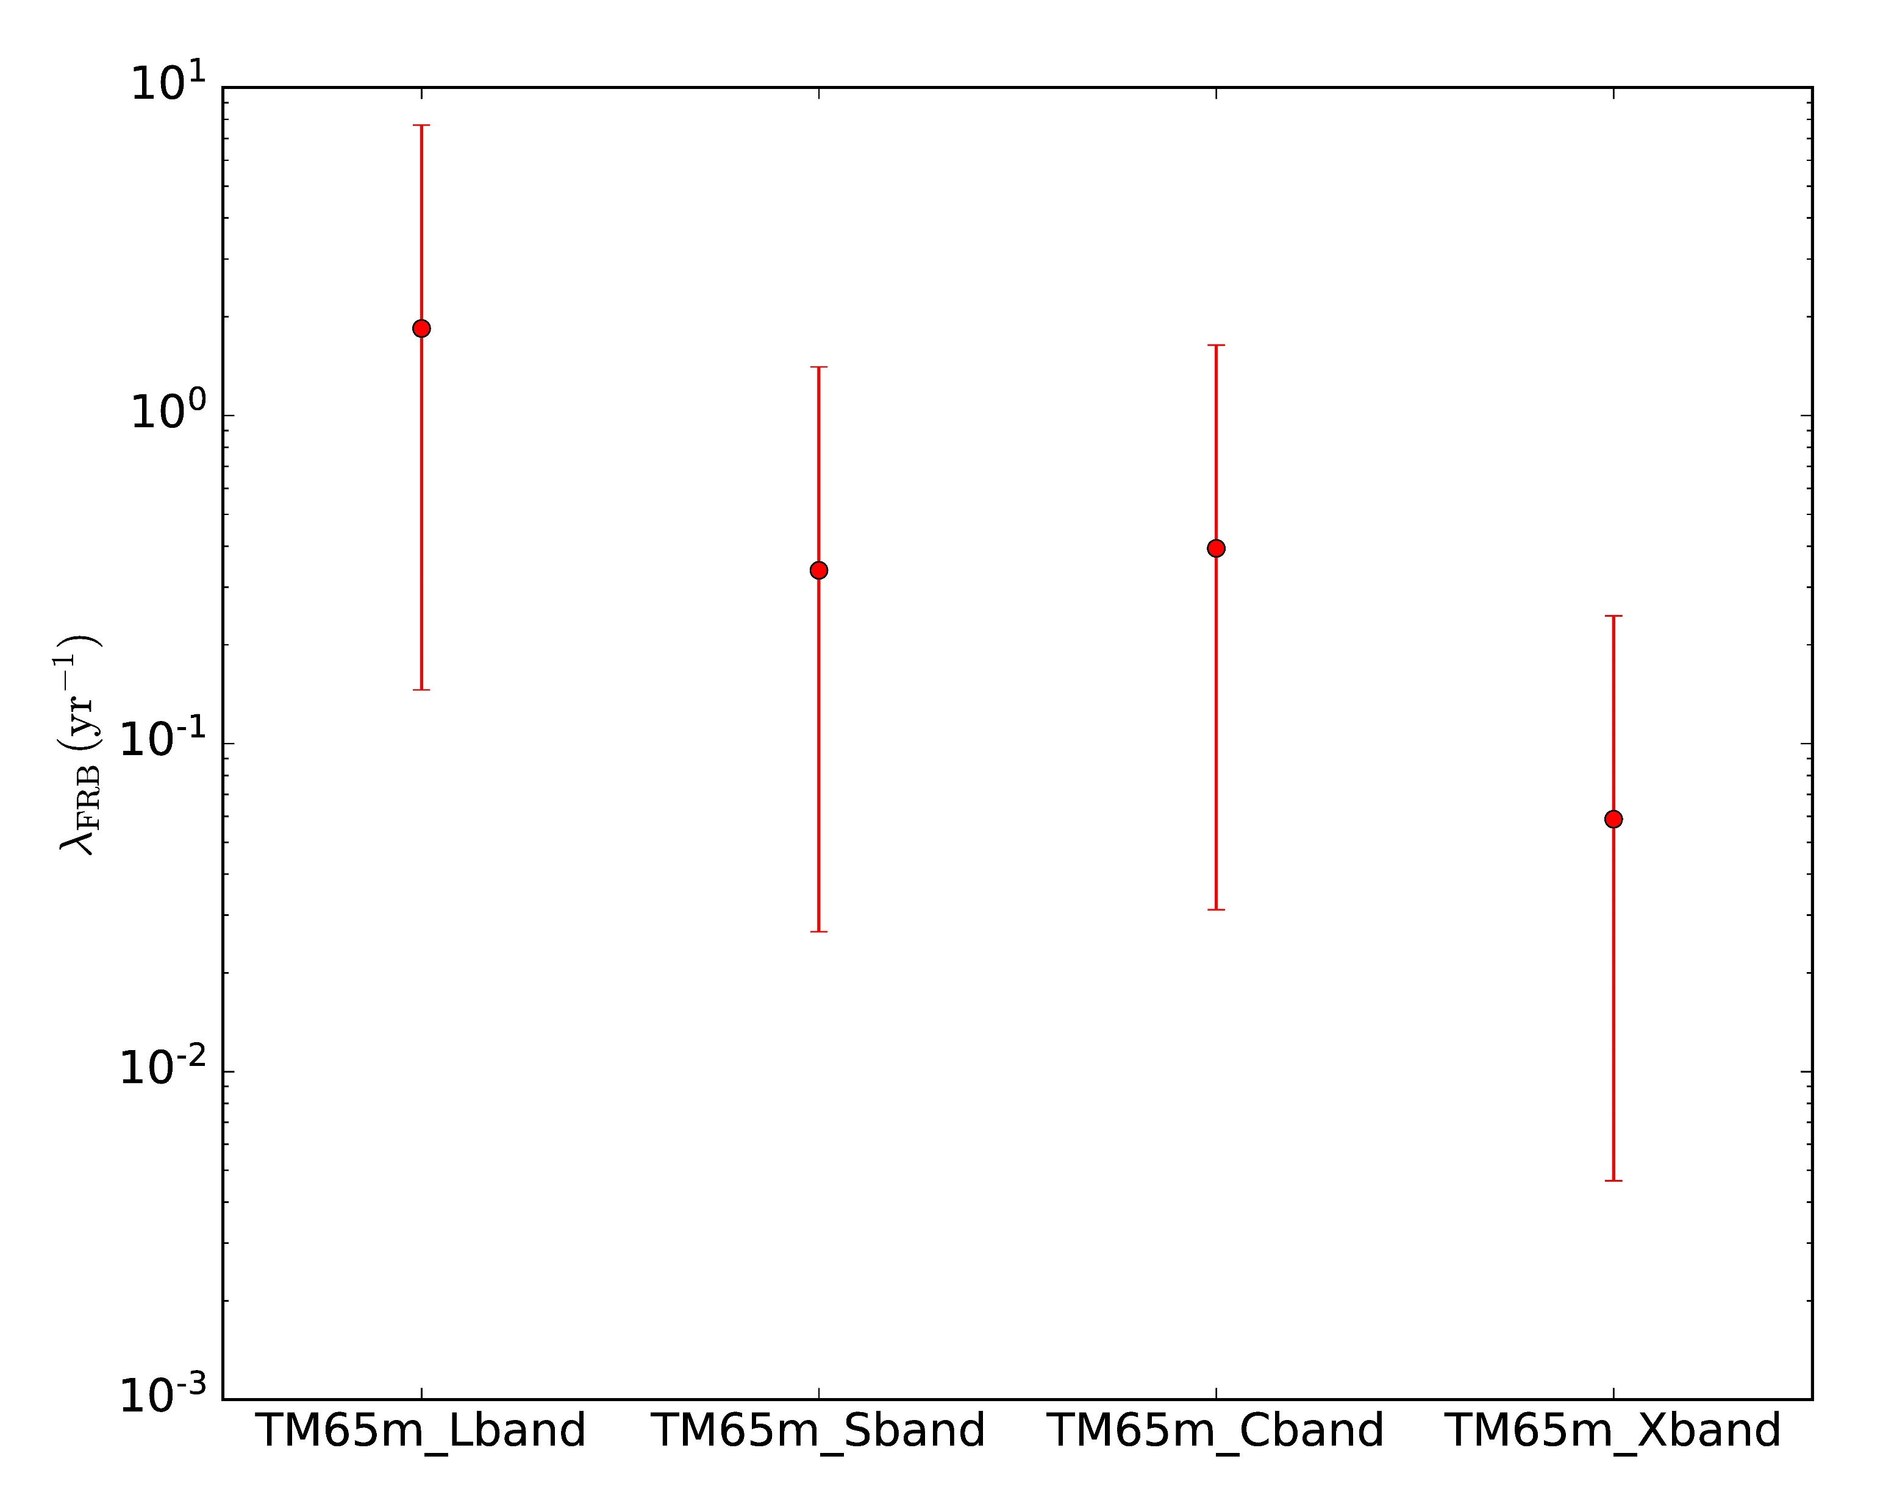
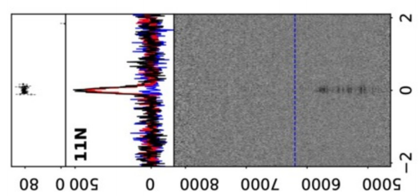
The real-time FRB detection: Background
FRB：
  Short Bright radio pulses;
  High Dispersion Measure(DM)
  Observe:
    Origin;
    Frequency range
    Repeating
    Polarization
    …
Detection rate at Tianma
Instrument:
  CHIME/ASKAP are powerful (400-800 MHz);
  Other bands are necessary;
  Real-time detection is convenient when other observations
From Luo Rui, PKU
FRB121102, GBT, 4-8 GHz

Slide 12
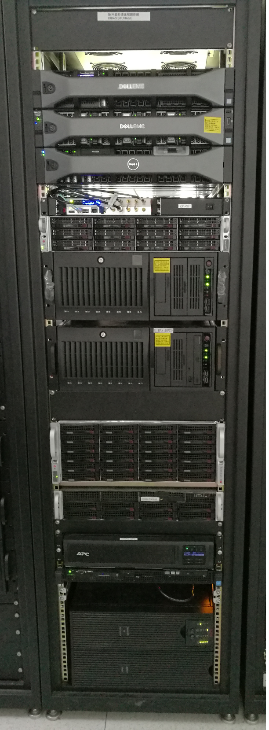
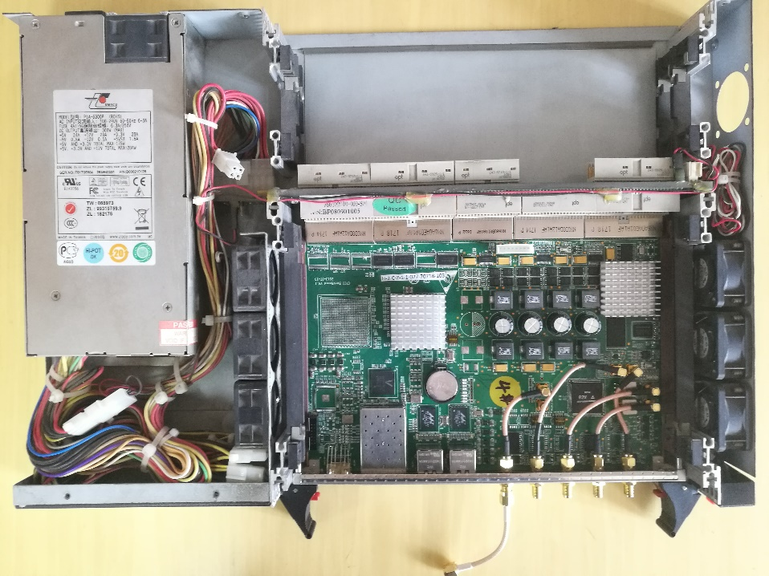
The real-time FRB detection: Hardware
ADC+FPGA+GPU for Digital backend
Dual Channel 1Gsps ADC, 8-bit;
Xilinx K7480t FPGA
10Gb Ethernet for data
H-maser for frequency standard
1U Rack
Intel® Xeon® Processor E5 2.2GHz 28 core;
128G DDR Ram
GeForce GT 1030 GPU
40 TB storage
GPU Storage Server

Slide 13
The real-time FRB detection: Pipeline
Real-time pipeline:
PFB: 1024 Channels
Clean RFI: clean frequency range
De-dispersion: dedisp with GPU
Detect: Candidate as SNR > 6, then Recording
FPGA
CPU/GPU

Slide 14
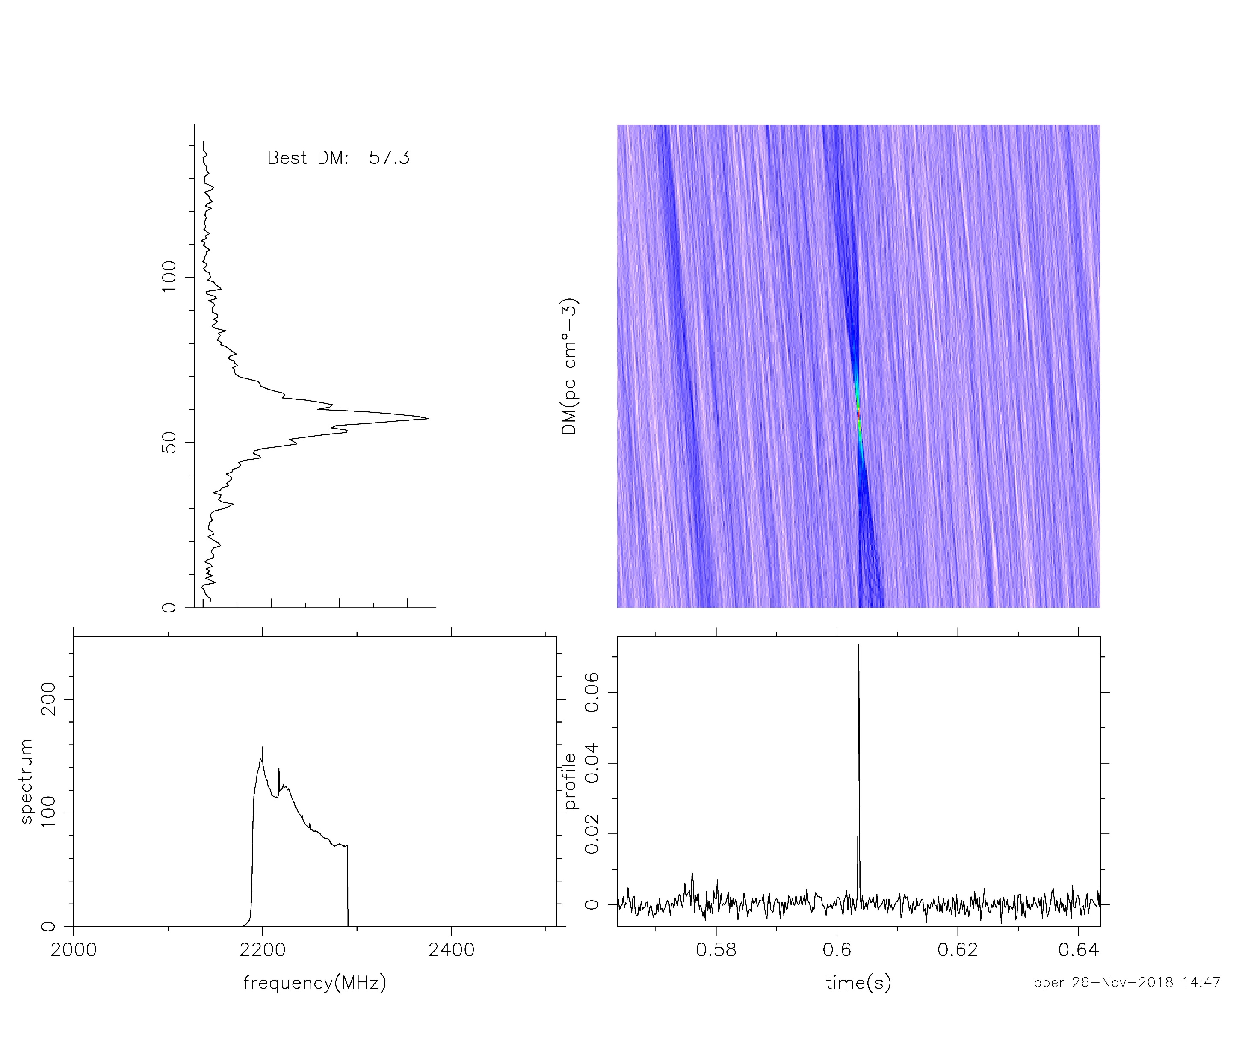
The real-time FRB detection: pulsar
Early in 2018, test the Pipeline
Giant Pulse of B0531+21
Record the data, then pipeline
S band, clean at 2180-2280 MHz

Slide 15
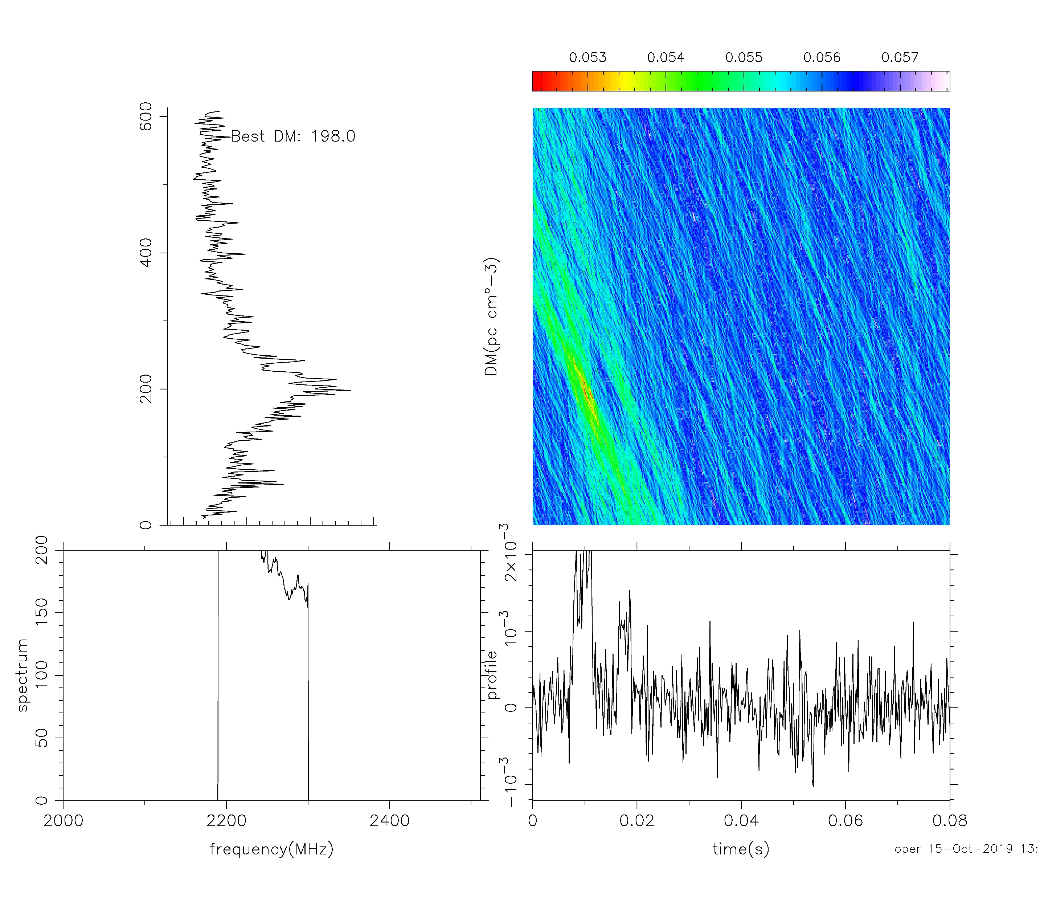
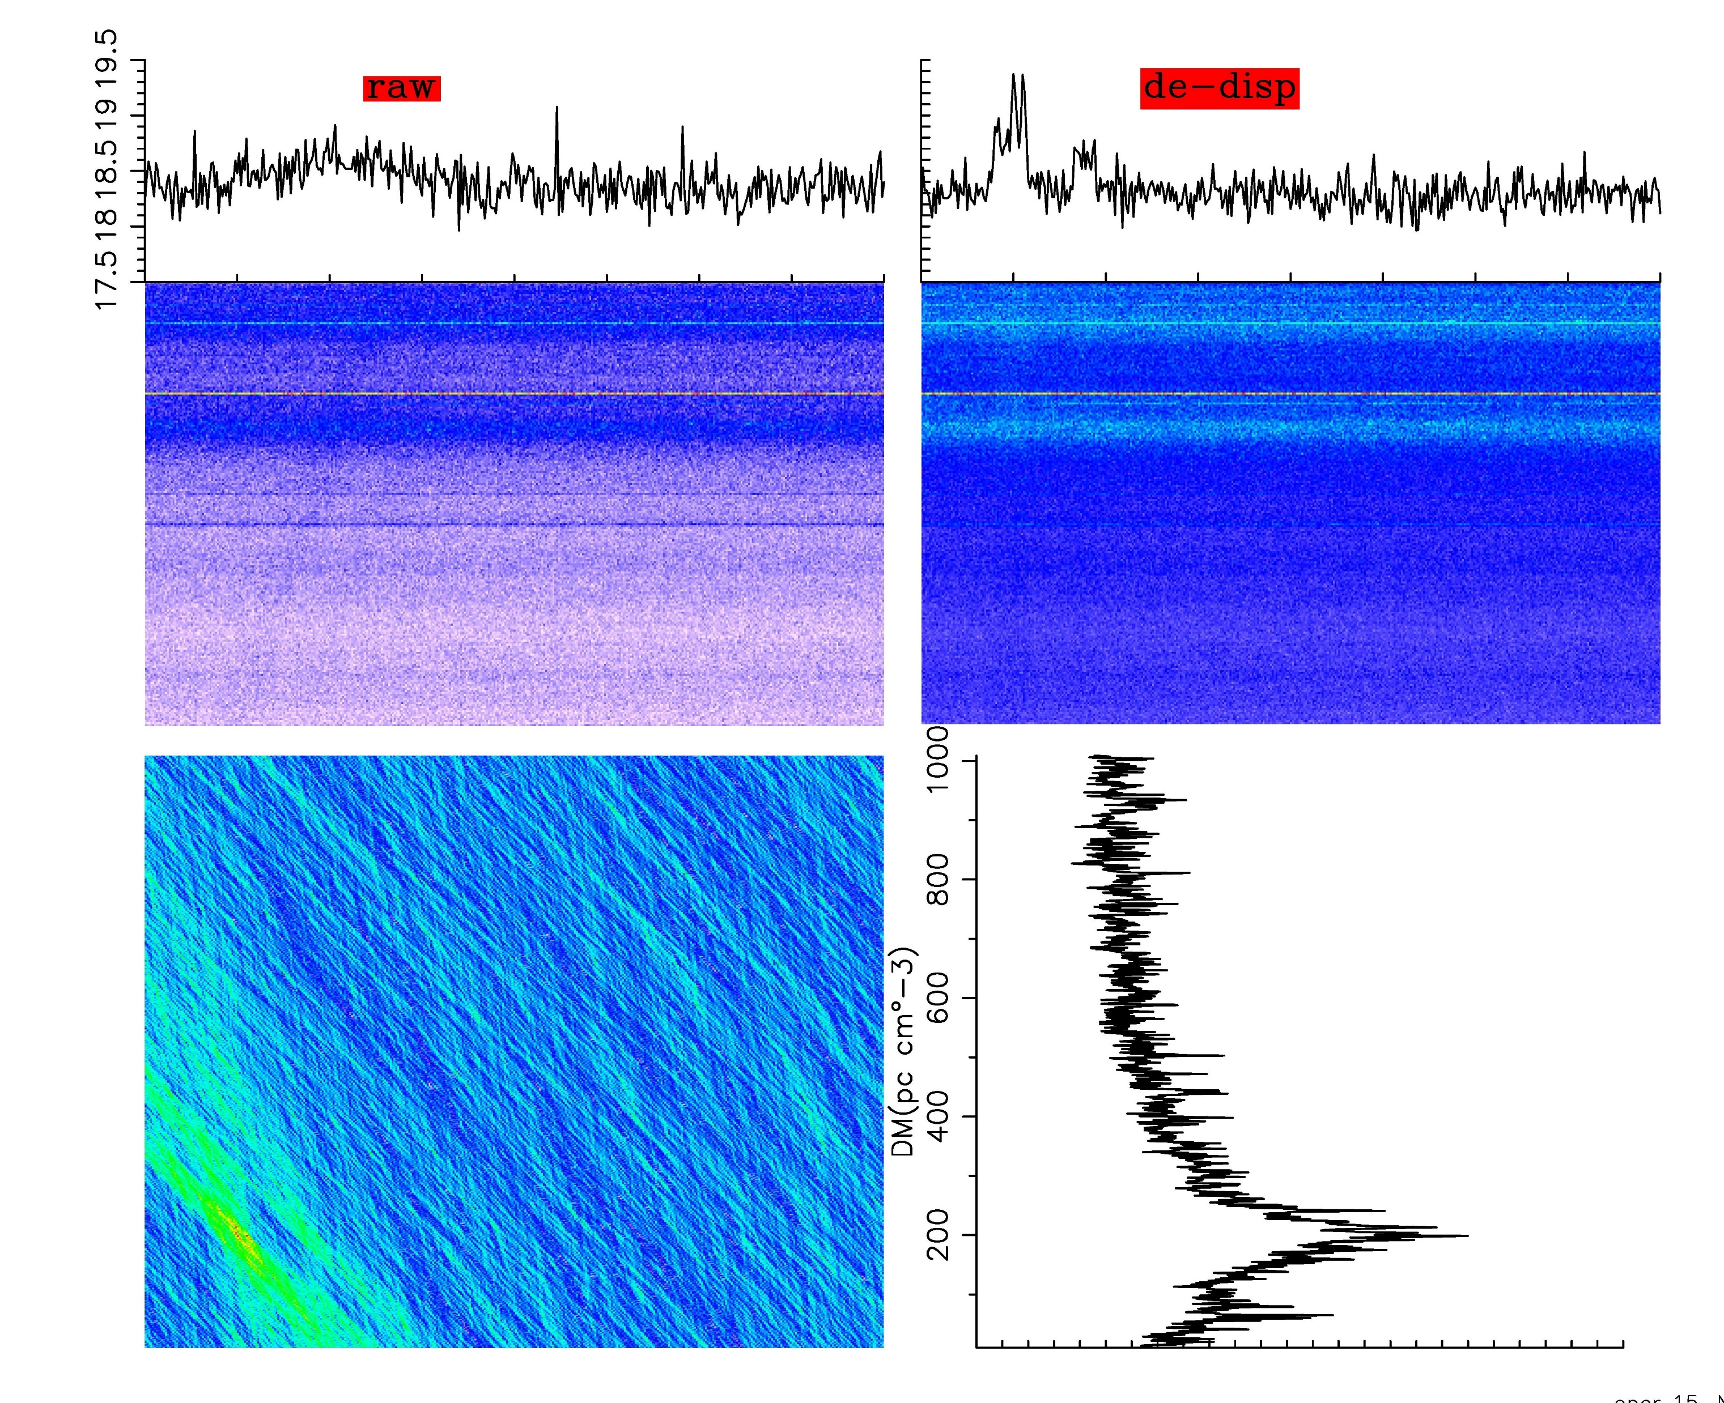
The real-time FRB detection: RRAT
RRAT (rotating radio transient) J1819-1458
Signal detected
Real-time
Further analysis

Slide 16
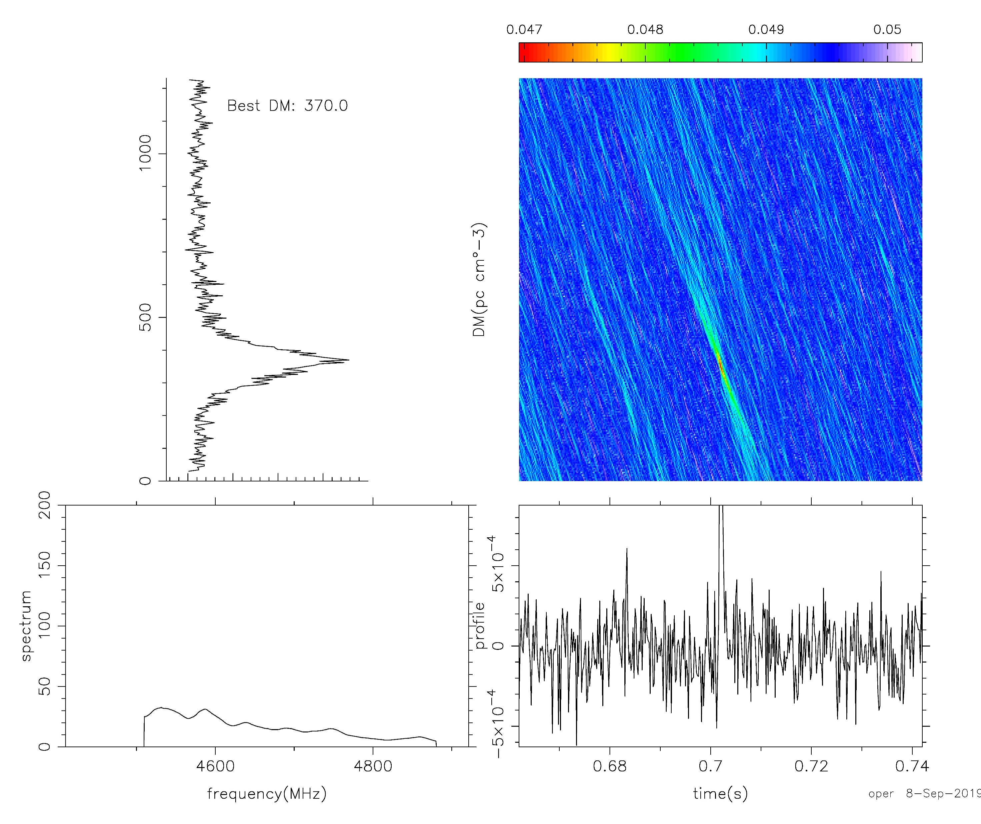
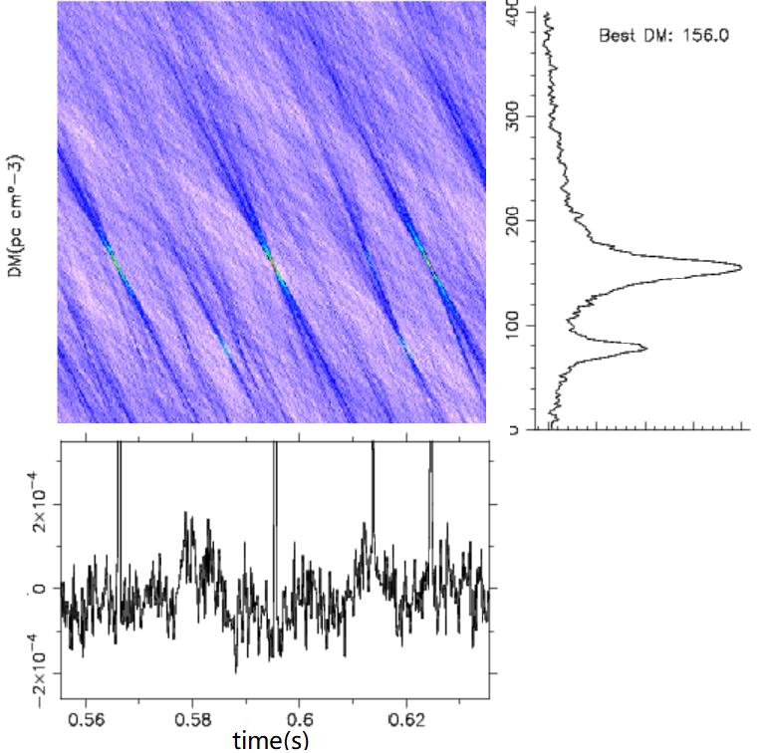
The real-time FRB detection: FRB
Repeating FRB121102, 20 hours(S, C band), NO Detection;
Strange RFI, the fake candidate;

Slide 17
The Backends: Conclusion
Wide-band, Universal, Transient detection, raw data recording;
Multi-feed; Array
逐步扩展至多功能终端

Slide 18
The Data
  Observation and Data
  Database

Slide 19
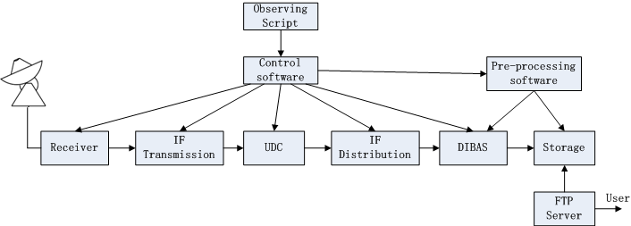
Observation
自动化的观测设置、数据预处理、用户数据拷贝；
用户通过FTP下载和查看观测数据；

Slide 20
Data
The Doppler to be included in future

Slide 21
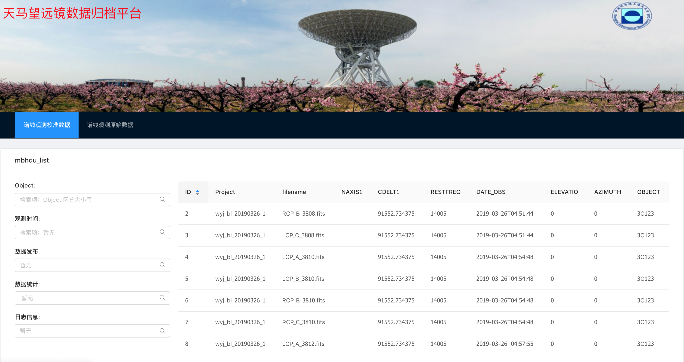
Database
正在建立谱线数据库；
212373数据文件，校准后的频谱；
初步完成了根据字段关键词进行检索
继续完善功能；
后续扩展至脉冲星

Slide 22
Database: future plan
数据检索
分类下载
在线数据处理及存储
数据可视化
硬件与软件的配置

Slide 23
Thanks for Attentions!

