Slide 1
VO and AstroInformatics Activities During the Last Decade in China
Chenzhou Cui
Chinese Virtual Observatory (China-VO)
on behalf of a larger collaboration

Slide 2
China-VO
Virtual Observatory (VO) is a data-intensively online astronomical research and education environment, taking advantages of advanced information technologies to achieve seamless, global access to astronomical information.
Chinese Virtual Observatory (China-VO) is the national VO project in China initiated in 2002 by Chinese astronomical community leading by National Astronomical Observatories, Chinese Academy of Sciences.
China-VO became a member of the IVOA with the recommendation of Dr. Jim Gray
R&D Focuses
China-VO Platform
Unified Access to On-line Astronomical Resources and Services
VO-ready Projects and Facilities
VO-based Astronomical Research Activities
VO-based Public Education

Slide 3
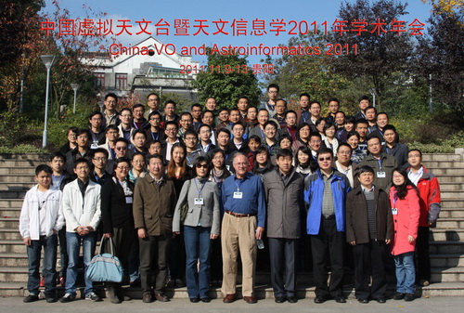
Community: China-VO annual meeting
year | attendees
2001
2003 | 36
2004 | 30
2005 | 27
2006 | 47
2007 | 40
2008 | 57
2009 | 63
2010 | 78
2011 | 75
2012 | 91

Slide 4
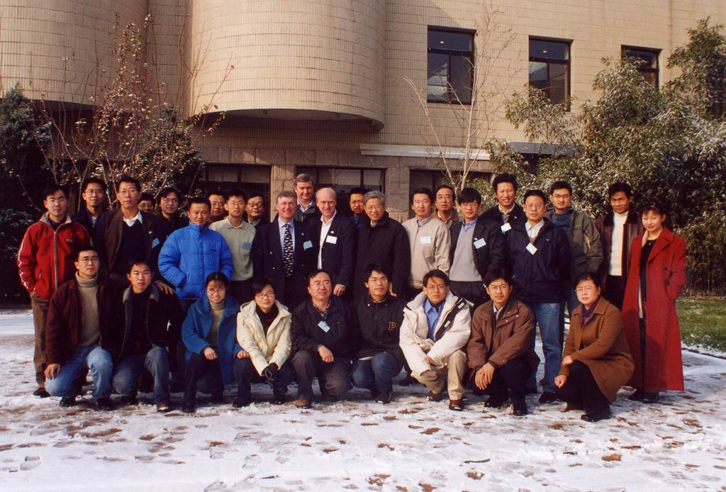
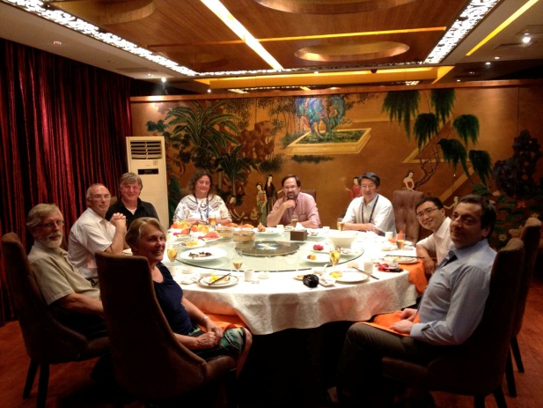
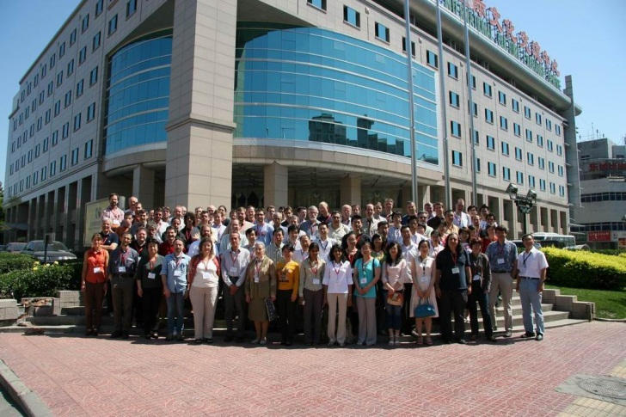
IVOA Events hosted by the China-VO
IVOA Small Project Meeting, 26-28 November, 2003
IVOA Interoperability Meeting, May, 2007
IVOA Exec Dinner, August, 2012

Slide 5
China-VO Team
Partners
NAOC (Beijing): Yongheng Zhao (PI), Chenzhou Cui (PM), Ganghua Lin, Yanxia Zhang, Boliang He, Changhua Li, Yue Chen, Yiming Teng, Zihuang Cao, Dongwei Fan, Jian Li, Haijun Tian, Zheng Li, …
TianJin Univ. (Tianjin): Jizhou Sun, Ce Yu, Jian Xiao, Qing Zhao, Xu Liu, Ao Yuan, …
CCNU (Wu Han): Xiaoping Zheng, Cuilan Qiao, Qin Wang, Jing Wang, …
Kunming Univ. of Science and Tech: Feng Wang, Kaifan Ji, Hui Deng, …
Collaborators:
Computer Network Information Center, CAS (Beijing): Baoping Yan, Kai Nan, Jianhui Li, Ze Luo, Kevin Dong, Yongzheng Ma, Lianglin Hu
Purple Mountain Astro Obs (Nanjing): Ji Yang, Liang Liu, Dengrong Lu, Jixian Sun, …
Shanghai Astro Obs (Shanghai): Yipeng Jing, Zhenghong Tang, Weipeng Lin, Xiao Chen, Shuhe Wang, Jianhai Zhao, Haiming Tang, …
Yunnan Astro Obs: Jinming Bai, Yufeng Fan, Chuanjun Wang, …
Tsinghua Univ.: Jianfeng Zhou, Zhihui Du
External collaborations:
JHU, MSR, Caltech, IUCAA, CDS, EMU/ASKAP, ICRAR (Australia), NAOJ (Japan)…

Slide 6


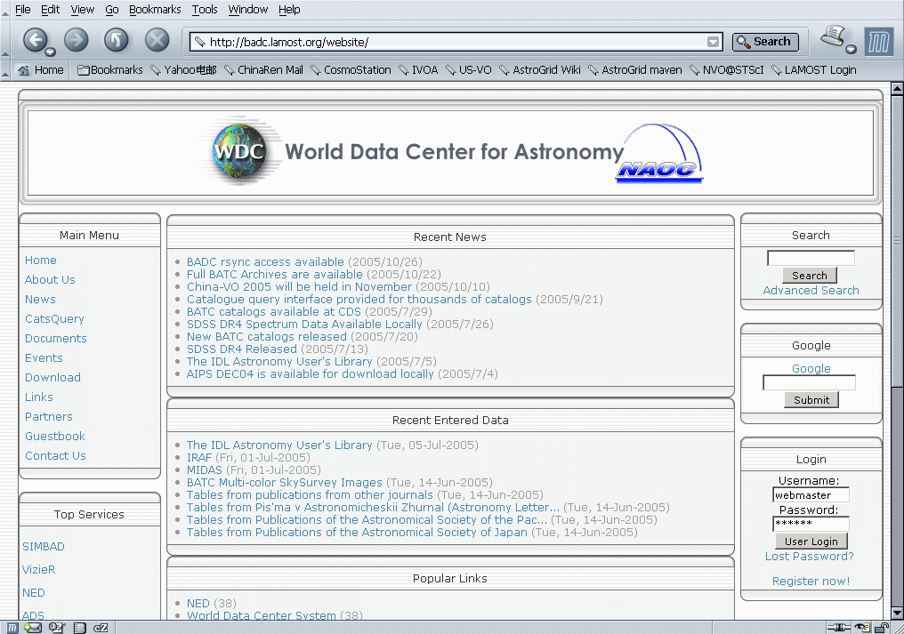
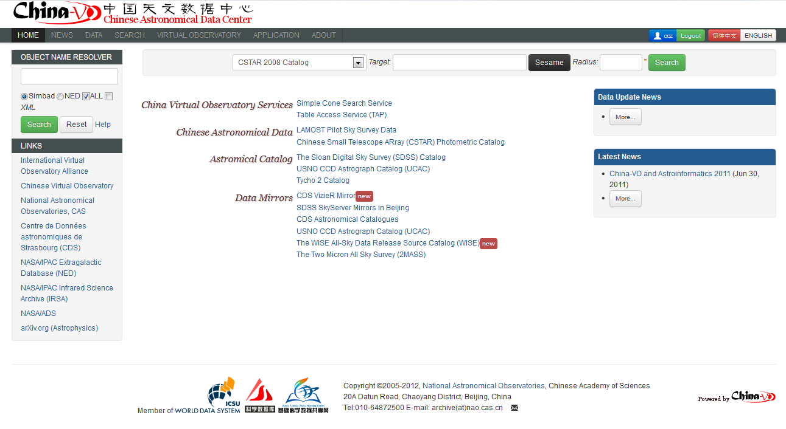
Data Access Services: BADC -> CAsDC
The CAsDC is based on World Data Center (WDC) for Astronomy, which is hosted at NAOC and has been providing data services to users since its initiation in 1980s.
In 2012, the CAsDC became a regular member of the new created Word Data System.

Slide 7
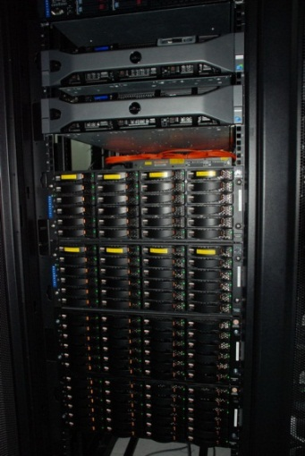
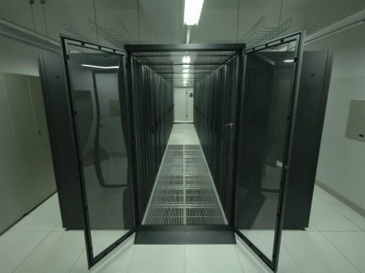
Data Resources at the CAsDC
From China
LAMOST Pilot Data Release
LAMOST Commission Data
The South Galactic Cap U-band Sky Survey (SCUSS)
CSTAR
BATC
LAMOST Sky Survey
Xinjiang radio telescope (25m)
Lijiang 2.4m telescope
Bootes-4 robotic observatory
Astronomical plates digitalization archive
International Mirrors
CDS Vizier
SDSS SkyServer
2MASS
WISE
Chandra
UCAC
USNO
ADS

Slide 8
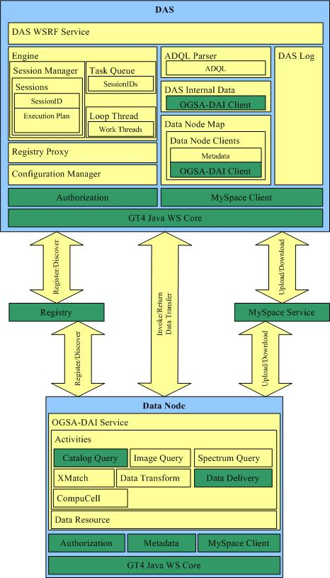

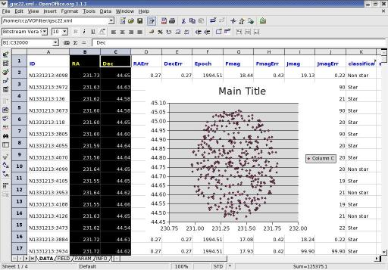
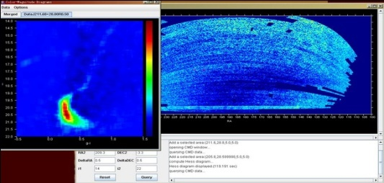
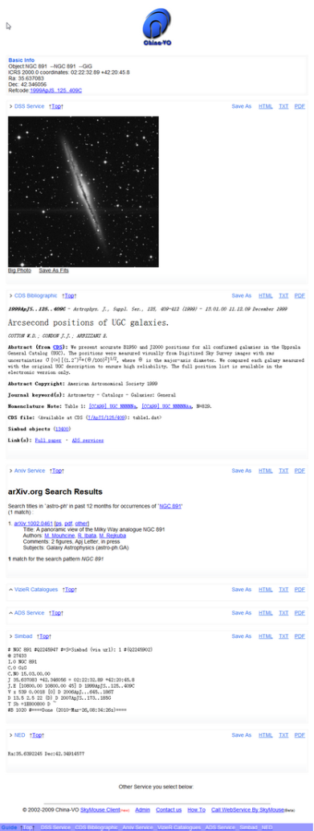
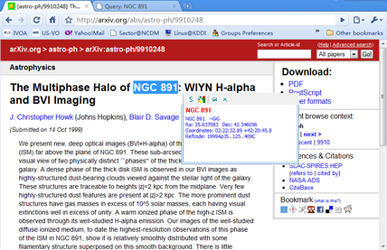
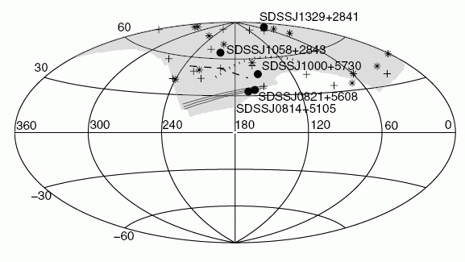
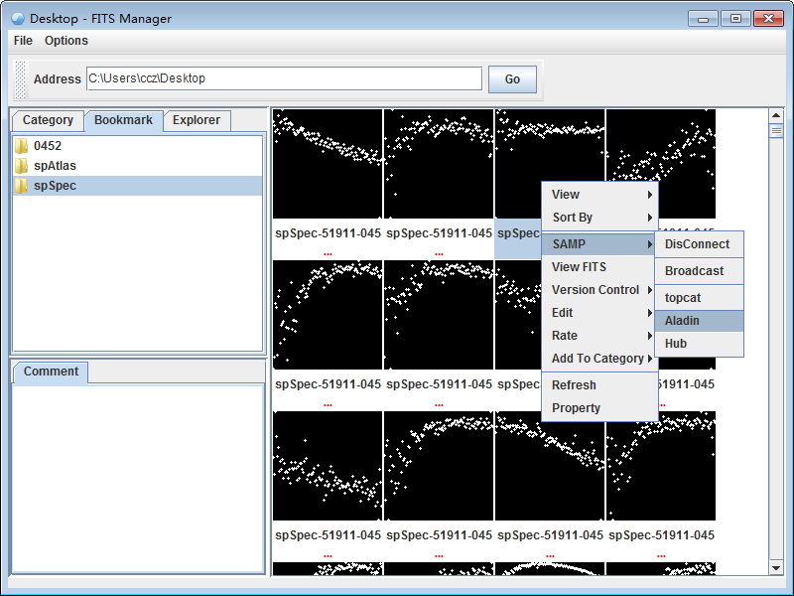
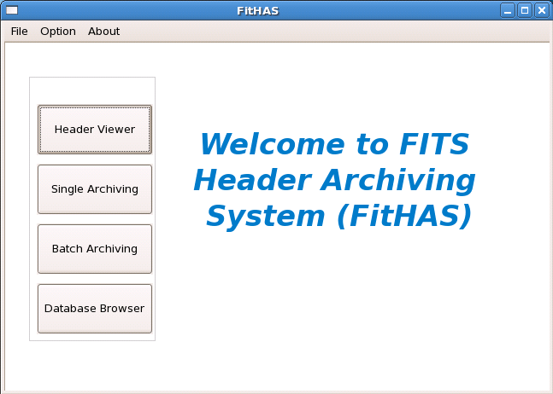
Tools Development
VO-DAS
VOFilter
SkyMouse
FitHAS
FITS Manager

Slide 9
First Science Paper from China-VO
Candidate Milky Way satellites in the Galactic halo（Liu et al., 2008, A&A)
SDSS DR5 photometric data were searched for new Milky Way companions or substructures in the Galactic halo.
Data analysis procedures were based on the VO-DAS.
Five candidates are identified as over-dense faint stellar sources that have color-magnitude diagrams similar to those of known globular clusters, or dwarf spherical galaxies.

Slide 10
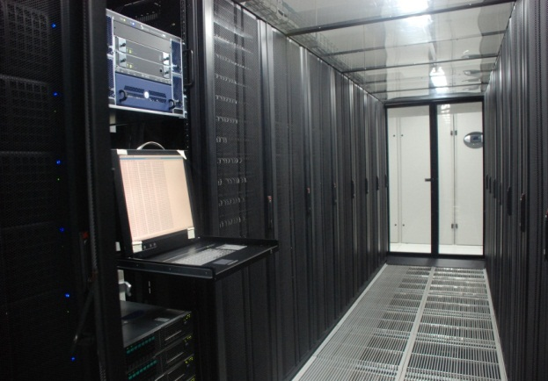
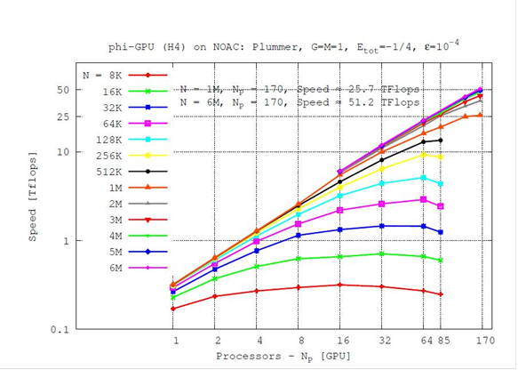
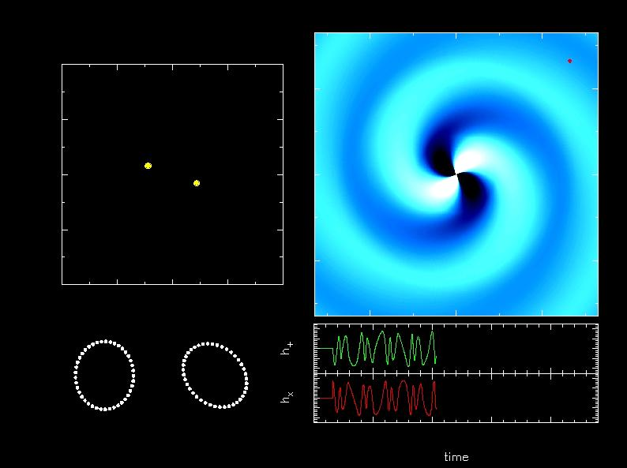
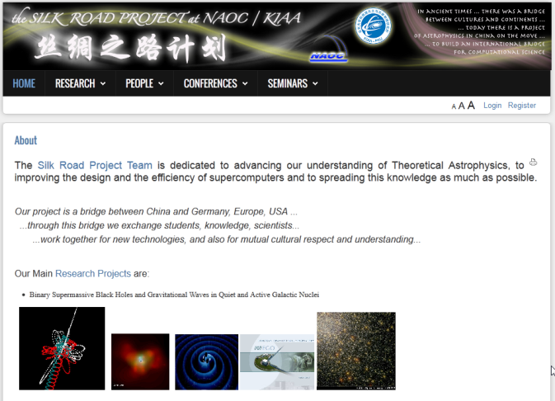
HPC: Laohu GPU cluster at NAOC
Left: NAOC GPU Cluster; The cluster is running with 85 nodes, each with two NVIDIA Tesla C1070 GPUs.
Right: Sustained Speed in Teraflop/s of astrophysical N-body Simulation for different particle numbers, as a function of number of GPU multiprocessors used. Near ideal speed-up is reached for large N, approaching the diagonal.

Slide 11
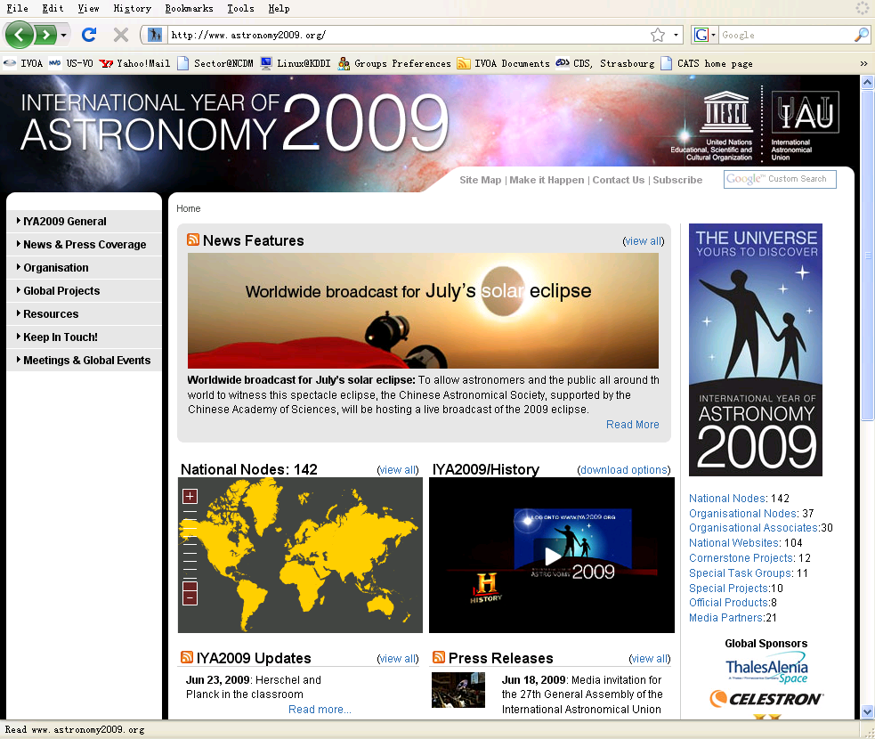
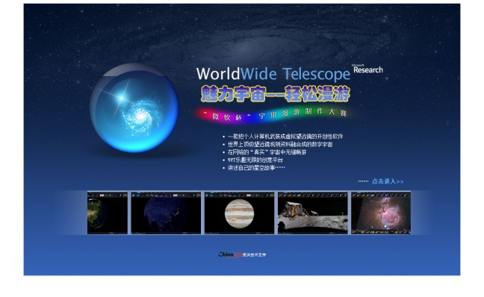
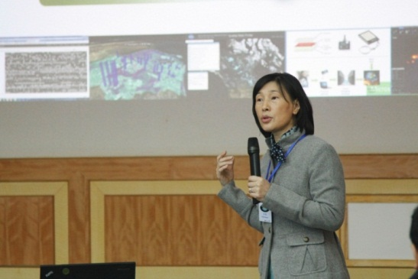
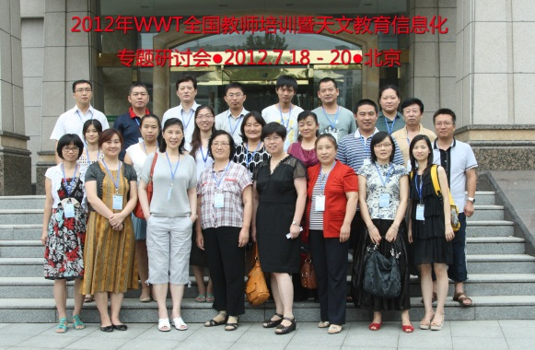
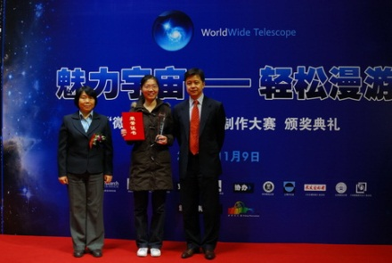
Scientific Data Based Education
Total Solar Eclipse Live Broadcast in IYA2009
WWT Guided Tour Design Contest
WWT Lectures and classes
WWT Teacher Training
  WWT teacher training 2010, Aug. 1-3, 2010
  WWT teacher training 2011, Jul. 22-26, 2011
  WWT teacher training in Haidian, Aug. 25-26, 2011
  WWT teacher training in Xinjiang, Apr. 25-26, 2012
  WWT teacher training 2012, Jul. 18-20, 2012

Slide 12
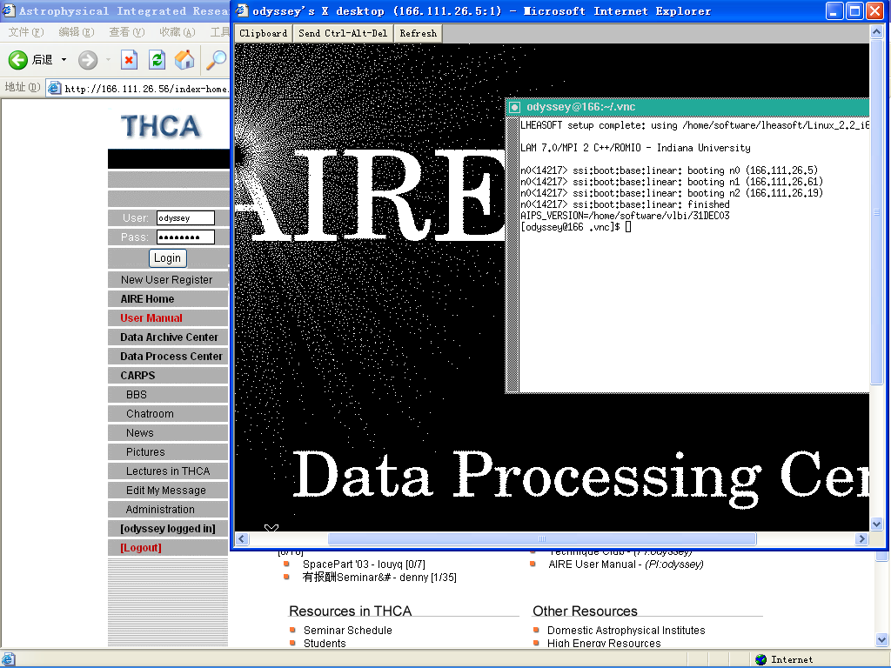
Astrophysical Integrated Research Environment (AIRE)
Provide a web-based collaborative research environment
Radio : Interferometry …, AIPS, AIPS++, Difmap…
Optical : Photometry … , IRAF, MIDAS …
X-ray : Coded-mask …, HEADAS ….
Contributed by Tsinghua University

Slide 13
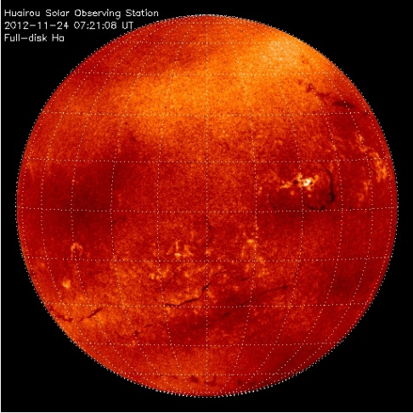
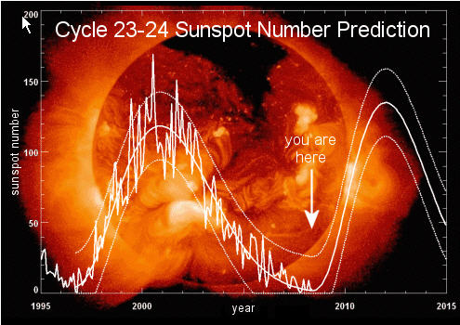
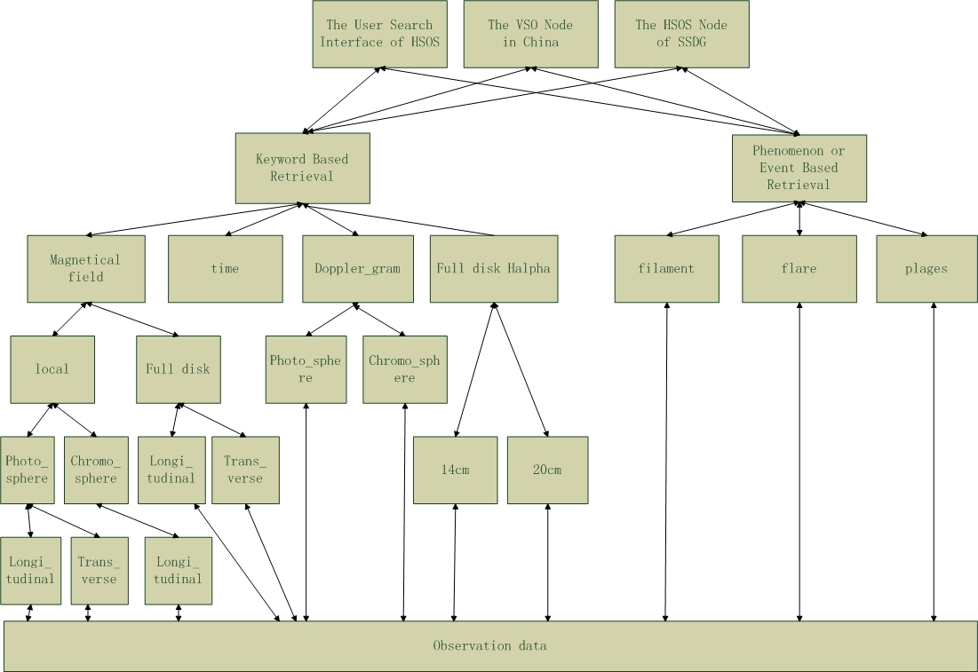
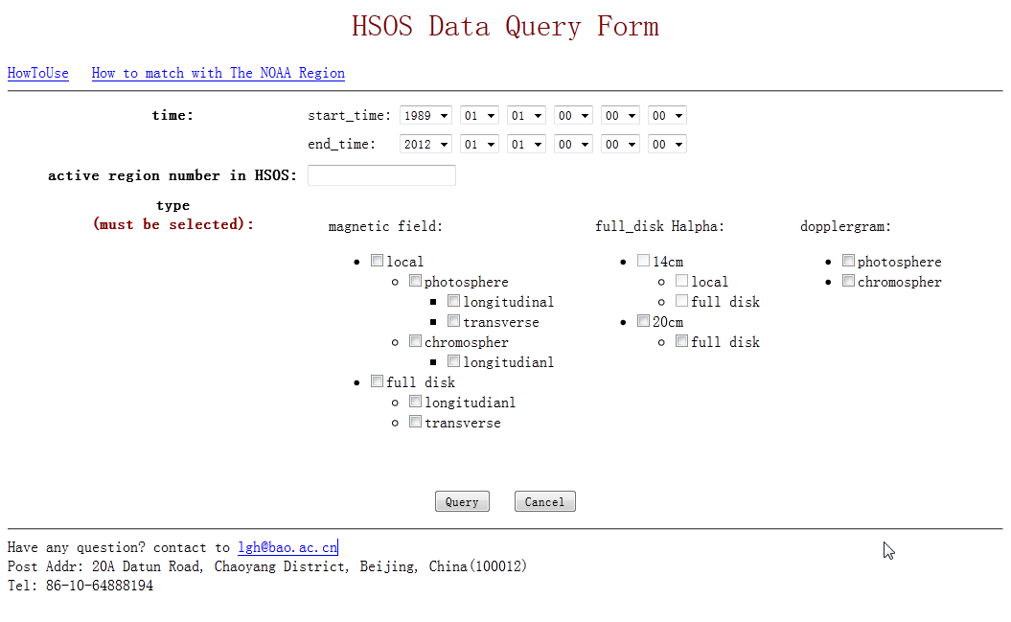
Virtual Solar Observatory
怀柔数据服务基础—
向空间环境预报提供数据服务
太阳特征自动探测
Latest H-alpha Images
The picture is the latest H-alpha image,and the webpage refreshs every 30s.

Slide 14
China-VO in 2012

Slide 15

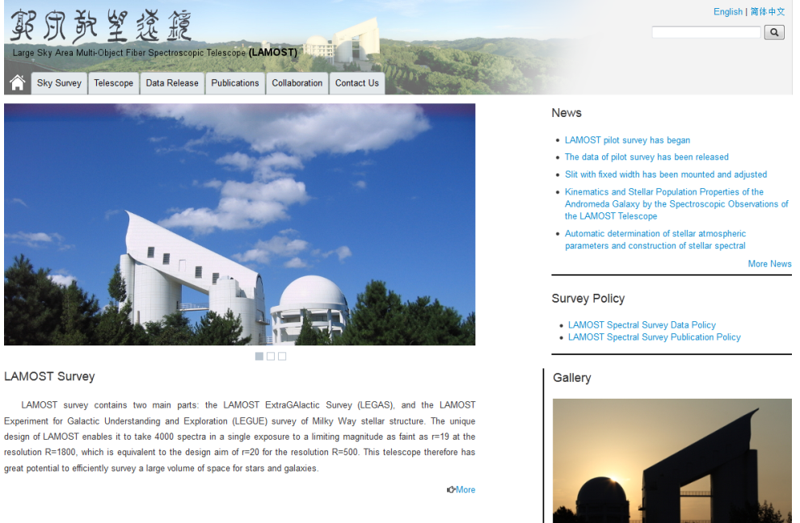
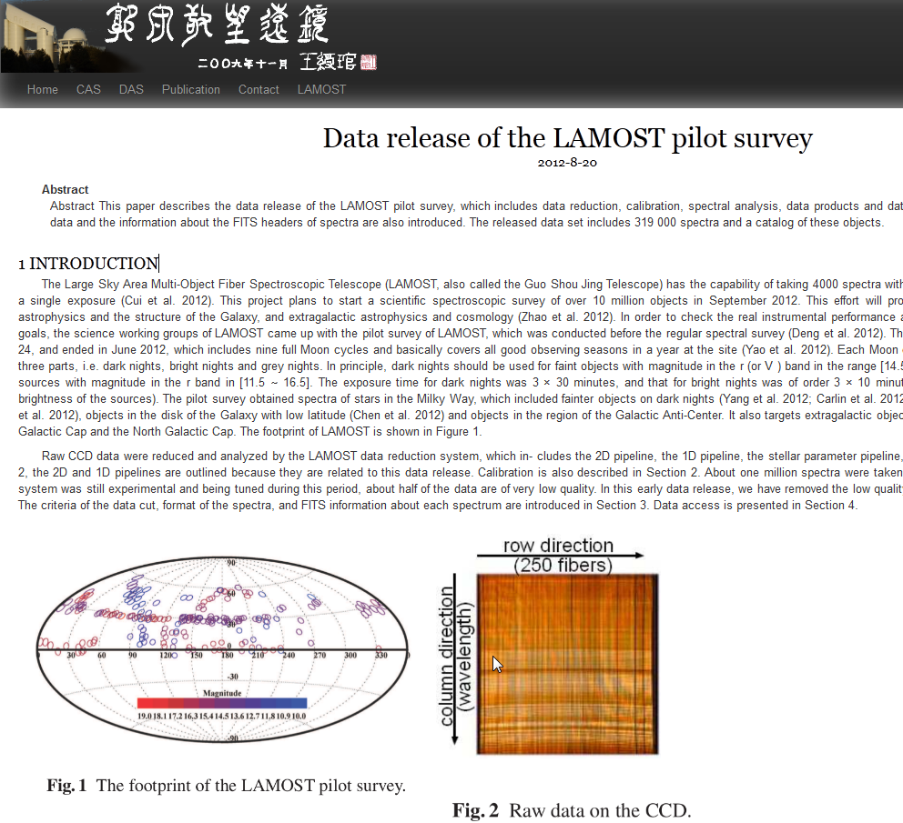
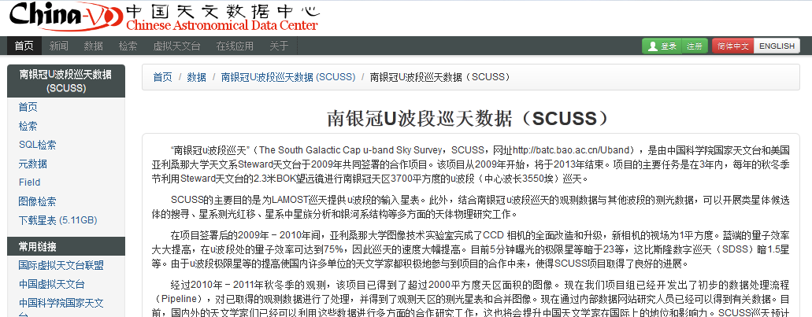


Slide 16

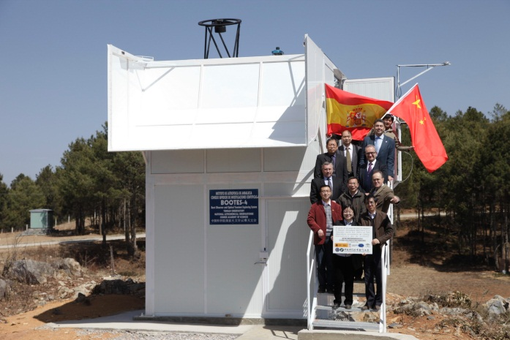
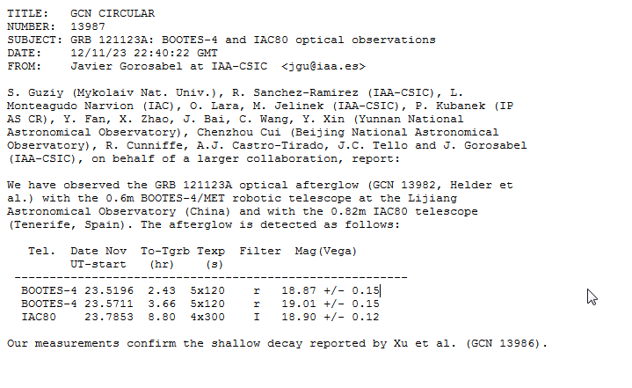
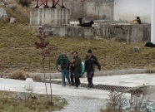
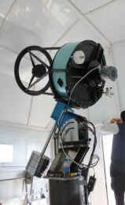
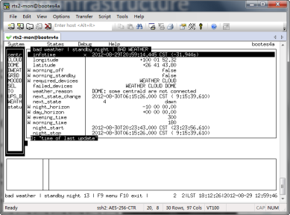
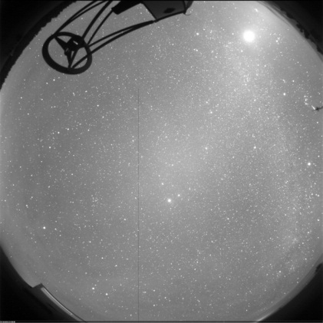
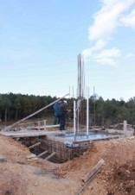
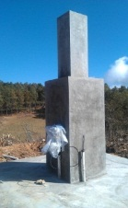
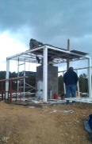
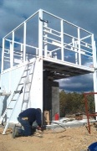
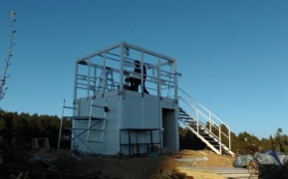
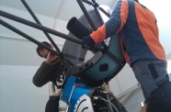
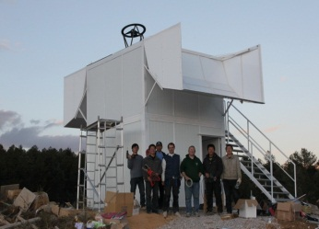
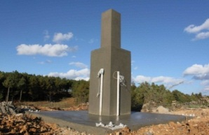
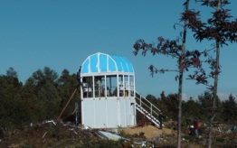
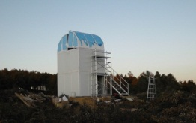
Bootes-4, the first professional RAO in China
The BOOTES Project: A world wide network of robotic telescopes
Good Infrastructure
  Remote control
  Autonomous observation
  Status monitor
  Data access
China-RAON
  A team to provide solutions and technical support
  NSFC projects in 2012

Slide 17
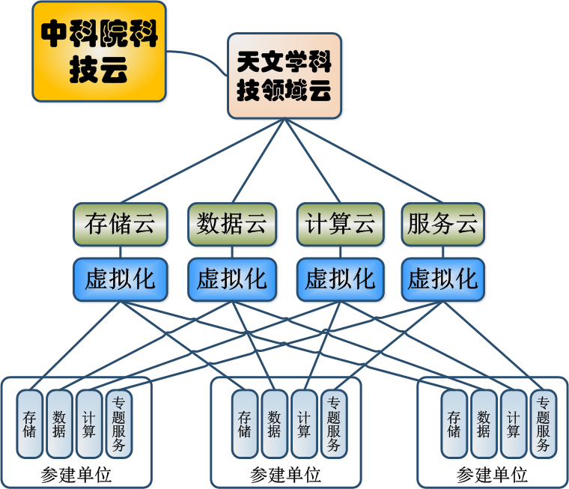


Scientific Cloud for Astronomy
利用云计算技术和虚拟化手段研究开发天文学科技领域云平台
集成现有天文学科技资源
构建物理分散逻辑统一的科研信息化环境
服务从望远镜时间申请一直到科学论文撰写的整个科学研究过程

Slide 18





Astronomical Plate Digitalization
我国各天文台站自1902年起累计拍摄了数万张底片，参加拍摄的工作人员超过300人。拍摄目标包括：小行星、彗星、双星、变星、耀星、新星、超新星、射电星、星团、星云、河外星系等等。这些底片真实地记录着拍摄时刻所对应天区的天象，也真实反映了中国现代天文学的发展历程。
科技部科技基础性工作专项重点项目
  总体目标：将我国现存的所有天文照相底片数字化，获得的底片信息库、图像库和星表将纳入中国虚拟天文台数据库中。供全世界天文学家使用，使这些珍贵的历史观测资料为现代天文学研究做出不可代替的贡献。
1902年5月16日佘山40厘米双筒望远镜拍摄的天鹅座底片。

Slide 19





WWT Planetarium in Chongqing
重庆市九龙坡区石新路小学将与国家天文台、微软研究院、华中师范大学合作，基于WWT建造国内首套纯数字互动式天象厅
“重庆市教育科研实验基地学校”、“九龙坡区示范小学”、“中国少年科学院科普实践基地”、“全国科学教育实验基地学校”、“重庆市科技特色学校”

Slide 20



WWT Booth at the 28th IAU GA

Slide 21


Wifi Service at the 28th IAU GA

Slide 22

A Brief Outlook
Data archiving, management, and access
  CAsDC, a national astronomical data center, data curation and long-term service
Resource integration and sharing
  Projects from NSFC, CAS and MOST
Closer collaboration with astronomers and astronomical projects
  Specific requirement targeted research and development (RAO, GPU,..)
Scientific data based education and public outreach
  WWT and WWT driven planetarium
  Training the next generation
    Computational thinking
    Citizen science
Community and users
  AstroInformatics

Slide 23
Thank You

Slide 24
Acknowledgment

Slide 25

Acknowledgment
VIP
LOC
Sponsors
  LAMOST
  宇宙暗物质与暗能量研究团组
  国家天文台——昆明理工大学天文信息技术联合实验室
Partner
All of you!

Slide 26

China-VO 2013, Nov. 14-17, Urumqi

